Slide 1
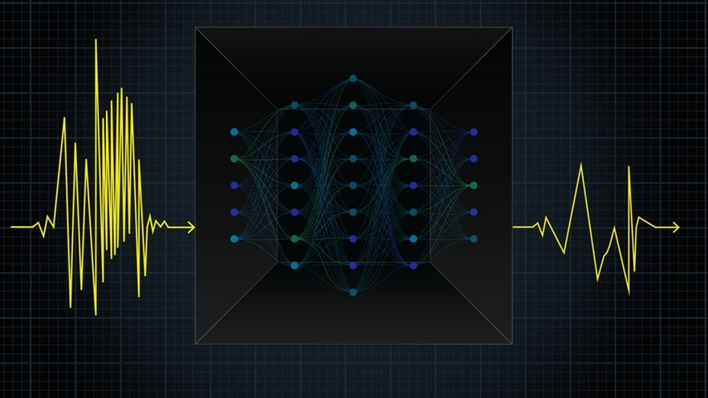
GEOL593: Seismology and Earth Structure, Spring 2023
Lecture 13: Machine Learning in Seismology
Part 2

Slide 2
Class schedule
 | Dates | Topic | Lab assignment
Week 1: | Jan 17, Jan 19 | Course overview | Lab 1: Python crash course
Week 2: | Jan 24, Jan 26 | Seismic signal processing | Lab 2: Introduction to Obspy
Week 3: | Jan 31, Feb 2 | Moment Tensors/ Inverse methods | Lab 3: Moment tensor inversion
Week 4: | Feb 7, Feb 9 | 🤮 No class, Ross ill | Seismic wave propagation 1
Week 5: | Feb 14, Feb 16 | Lab 4: Reference Earth models: The “1D” Earth | Seismic wave propagation 2
Week 6: | Feb 21, Feb 23 | Lab 5: Surface wave dispersion | Surface waves and normal modes
Week 7: | Feb 28, Mar 2 | Lab 6: Normal modes | Imaging Earth Structure 1: Seismic tomography
Week 8: | Mar 7, Mar 9 | Lab 7: Seismic Tomography | Imaging Earth Structure 2: Seismic discontinuities / Research paper discussion
Week 9: |  | Spring break
Week 10: | Mar 21, Mar 23 | Lab 8. Receiver Functions | Anisotropy and anelasticity
Week 11: | Mar 28, Mar 30 | Planetary seismology 1 | Lab 9: InSight- Seismology on Mars
Week 12: | Apr 4, Apr 6 | Planetary seismology 2
Week 13: | Apr 11, Apr 13 | Machine learning in seismology 1 | Lab 10: Earthquake detection
Week 14: | Apr 18, Apr 20 | Machine learning in seismology 2
Week 15: | Apr 25, Apr 27 | Frontiers of seismology: What’s next? | Research Paper Presentations (?)
Week 16: | May 2, May 4 | Research paper presentations | Reading Day

Slide 3
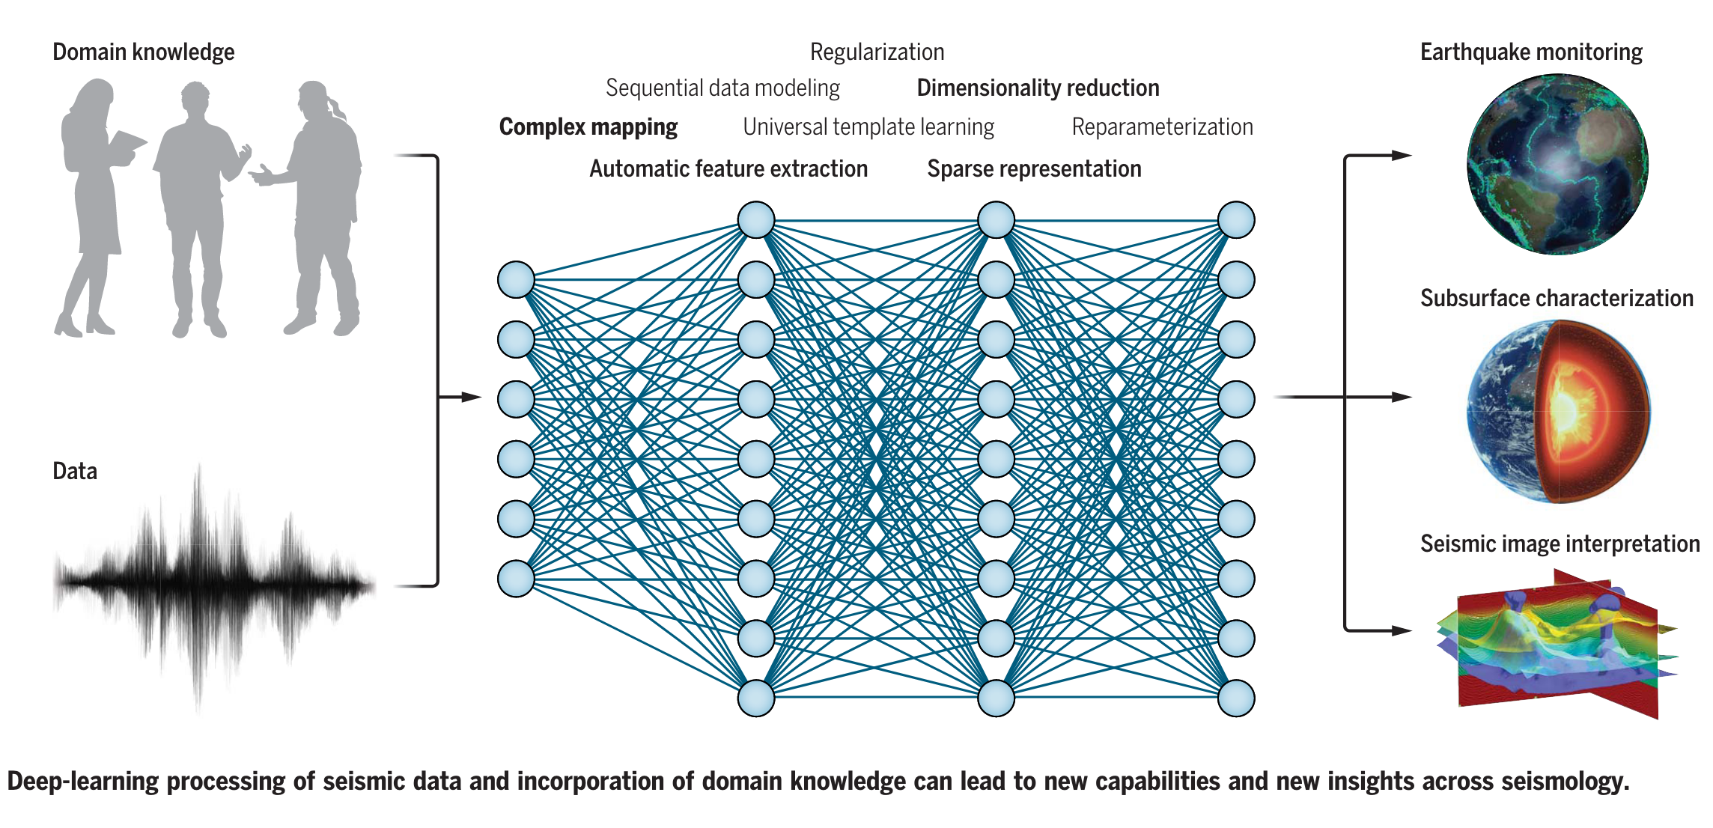
Deep learning in seismology
What is deep learning?
Deep learning is a type of machine learning that uses neural networks to analyze and learn from data. The ‘deep’ part is in reference do the fact that neural networks typically have many layers that allow it to learn complex representations of the data.
Mousavi & Beroza, 2022, Science

Slide 4
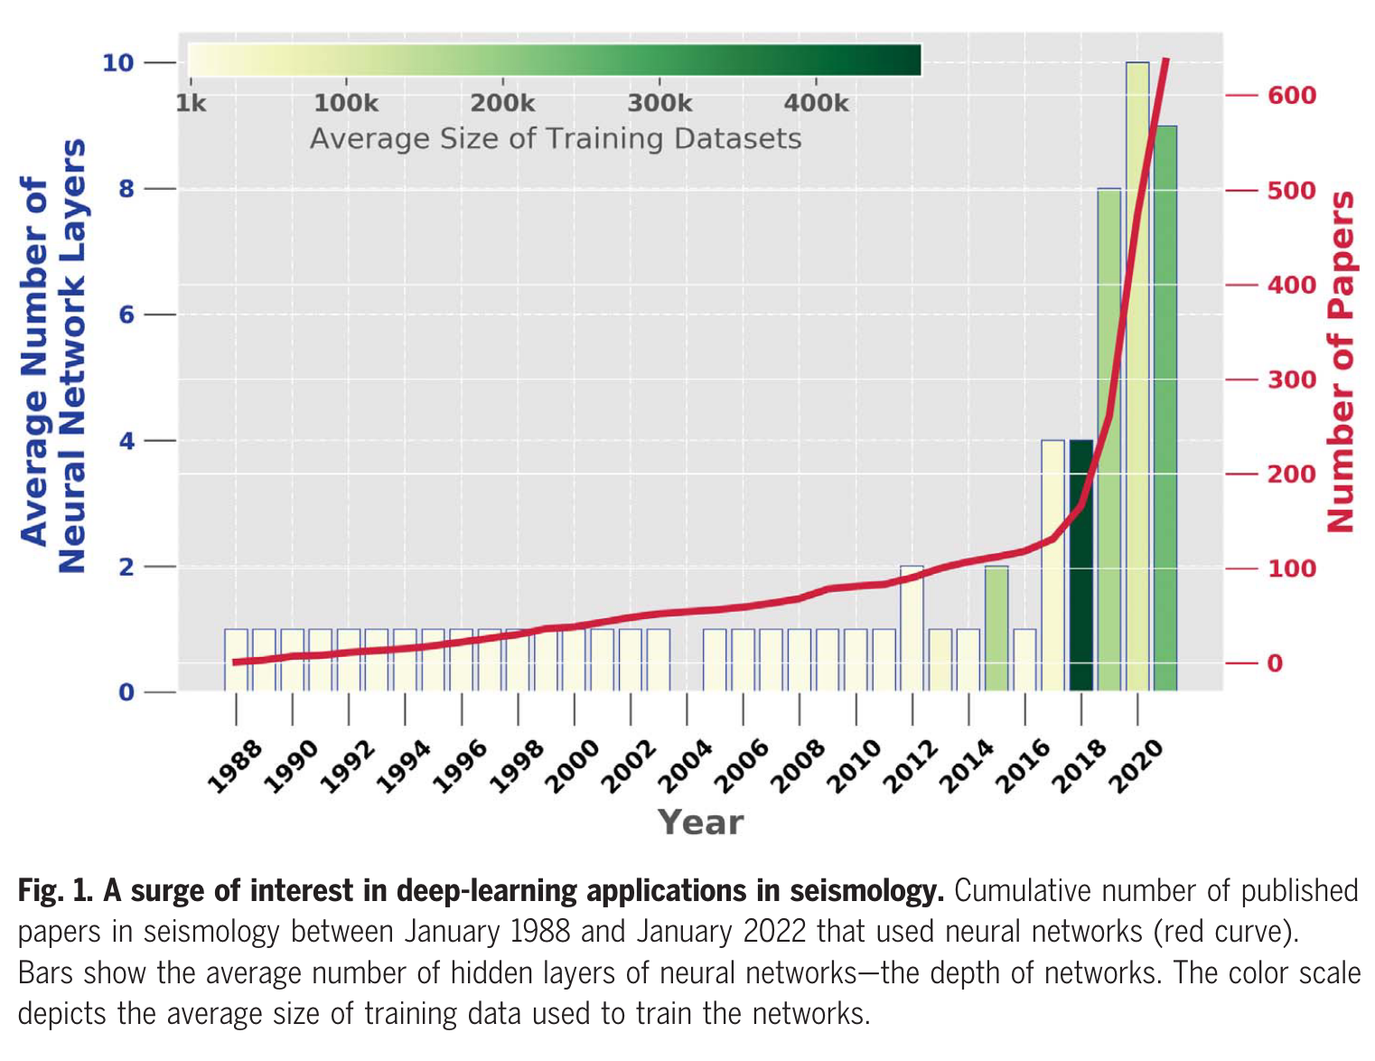
Applications of deep learning in seismology
Deep learning has found application in almost all subfields of seismology, including
Earthquake detection
Phase picking
Seismic image processing / interpretation
Forward modeling
Inverse modeling
The amount of seismology research using deep learning has surged and shows no signs of slowing down!
Mousavi & Beroza, 2022, Science

Slide 5
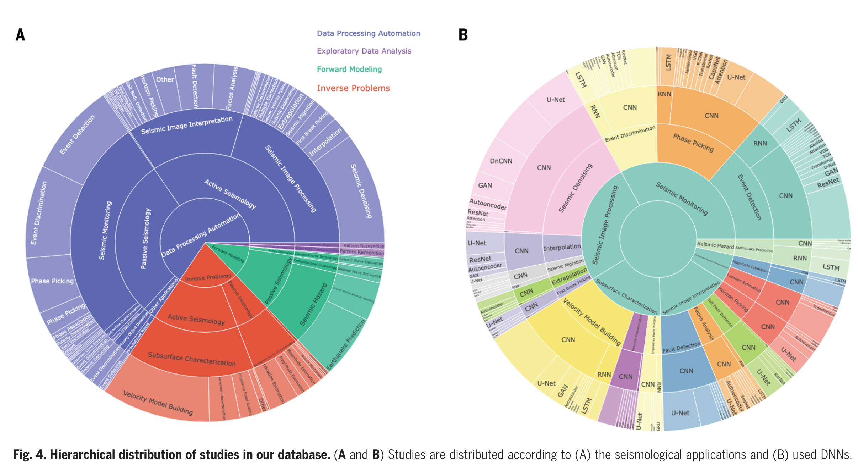
Areas of research
Mousavi & Beroza, 2022, Science

Slide 6
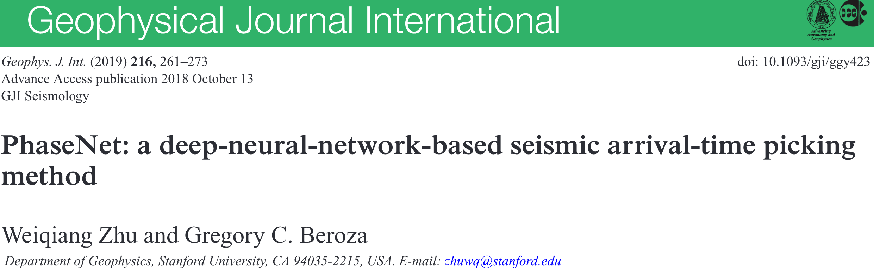
Motivation
Earthquake occurrence statistics and associated seismic hazard models rely on accurate seismic event detection.
It is challenging for trained analysts to keep up with picking seismic phases from the growing volume of data.
Trained seismic network analysts have produced large labeled data sets, which deep learning models can take advantage of.
Deep learning models may be able to achieve super-human performance at phase picking, while being computationally efficient and able to operate in near real-time.

Slide 7
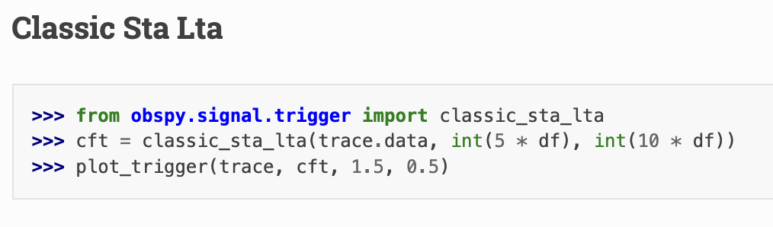
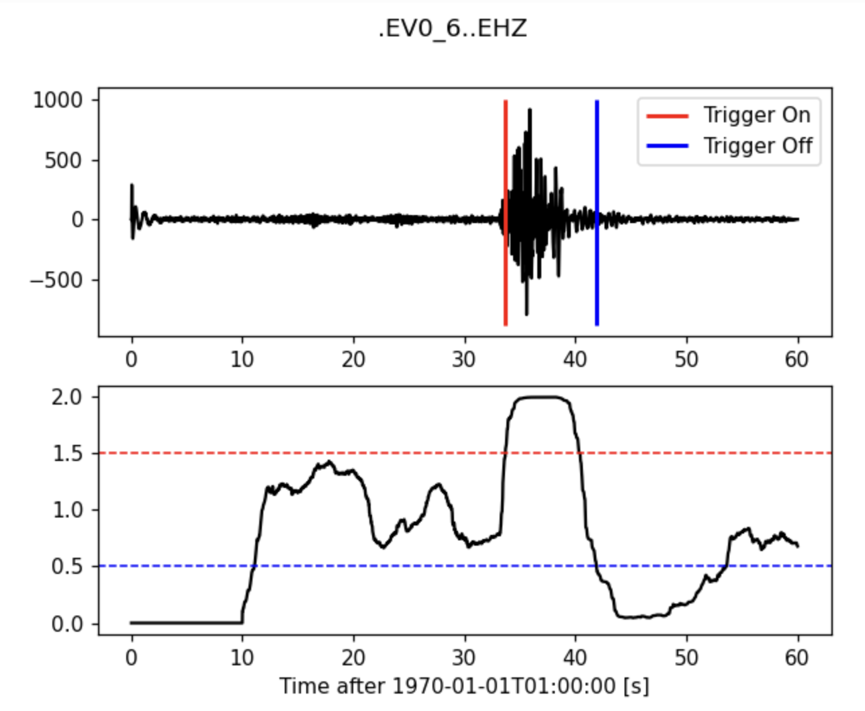
Classical phase picking approach: STA/LTA
The ratio of the average amplitude in a short duration window (short term average, or STA) to a longer duration window (long term average, or LTA), is often used as a way to detect seismic phase arrivals in continuous data.
The onset of a seismic phase will affect the STA more, causing a spike in STA/LTA
Easy to automate, but sensitive to noise, choices of window duration, and frequency band.

Slide 8
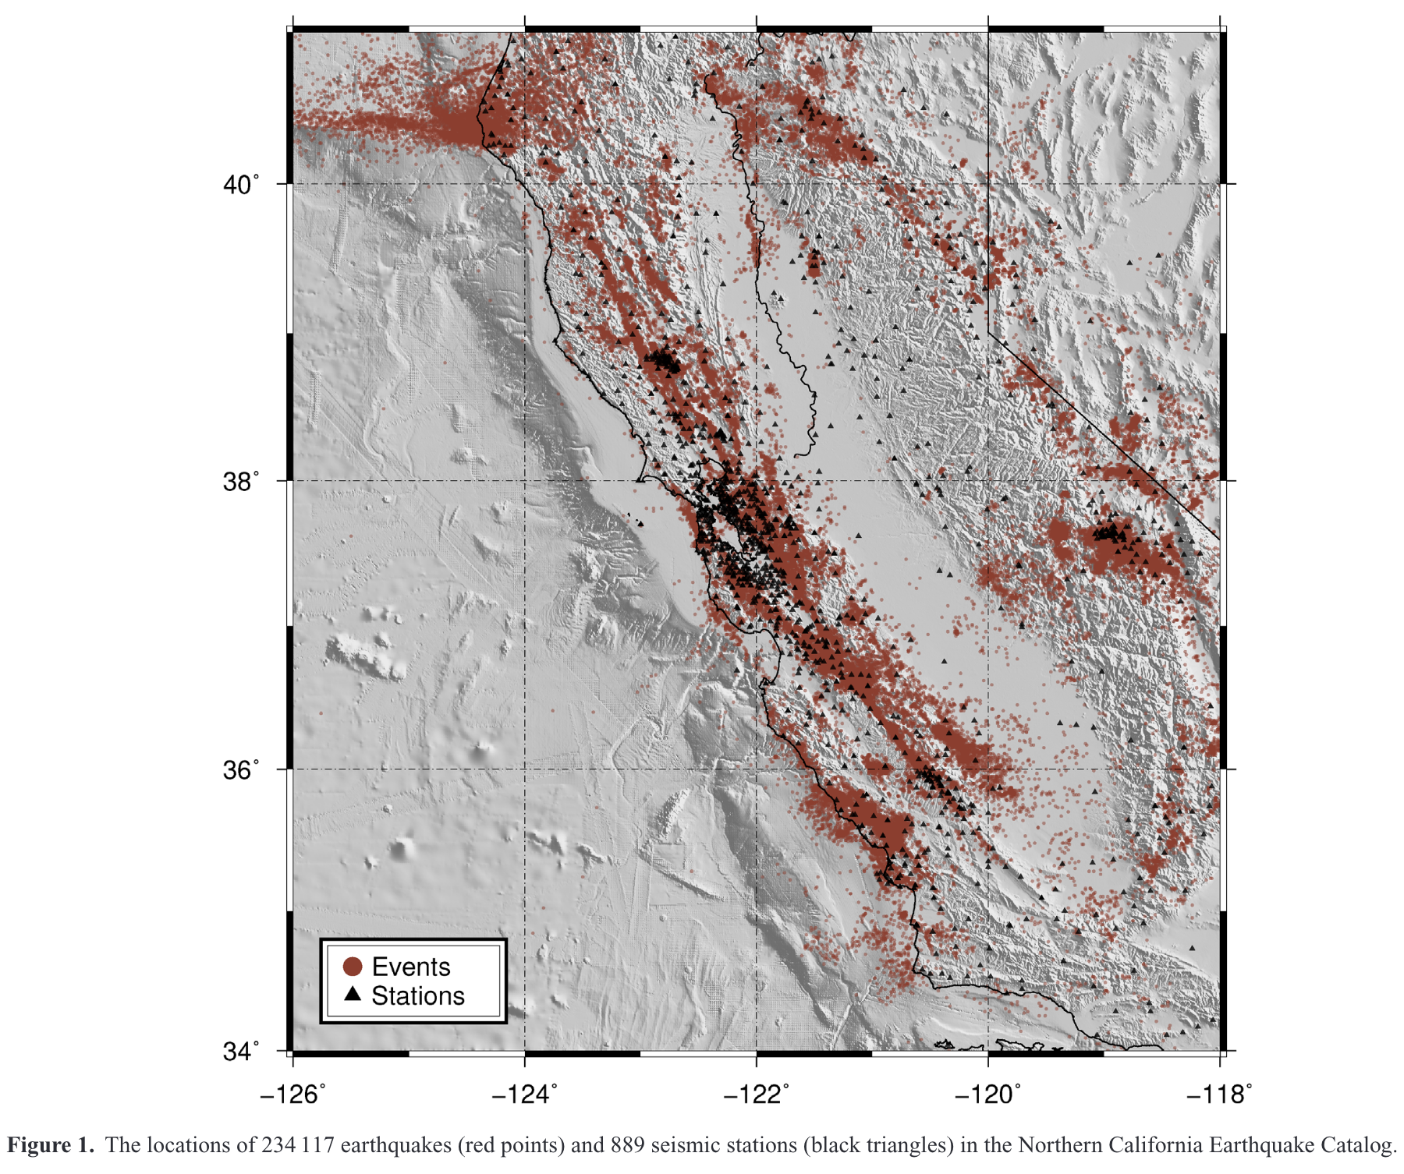
PhaseNet training data
> 30 years of 3-component earthquake waveforms from the Northern California Earthquake Data Center.
779,514 waveform examples, with labeled P and S arrivals.
Data set divided into 623,054 training samples, 77,866 validation samples, and 78,592 testing samples.

Slide 9
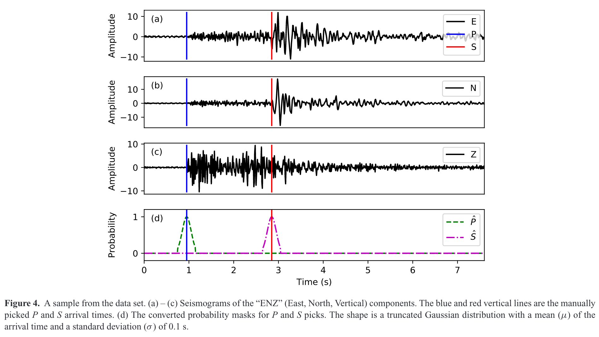
Probabilistic phase arrivals
To account for picking errors in the labeled dataset, a mask with the shape of a Gaussian distribution is applied around the manual picks.
The network then learns the to predict three probability distributions as a function of time: P-waves, S-waves, and noise.

Slide 10
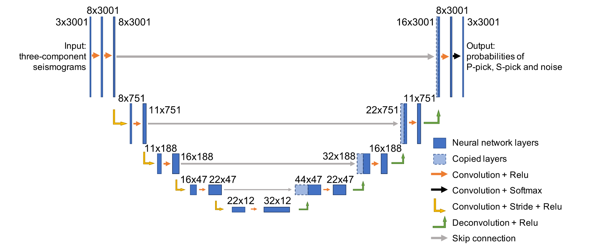
The “U-net”
Convolutional Neural Network (CNN) architecture with a contracting branch (‘encoding’ branch) and an expanding branch (‘decoding’ branch).
The encoding branch is a conventional CNN where convolutional layers are applied to learn high-level, sparse representations of the data
The decoding branch is used to ‘upsample’ the dimensionality. For example, so that the output of the network as the same size as the input.
Used heavily in ‘image segmentation’ problems.
Skip connection can be thought of as adding an identity matrix to the weight matrix of the layer
Neural network layers with skip connections are sometimes called ‘residual blocks’ because it allows the network to learn changes to the input. Helps mitigate the ‘vanishing gradient’ problem.

Slide 11
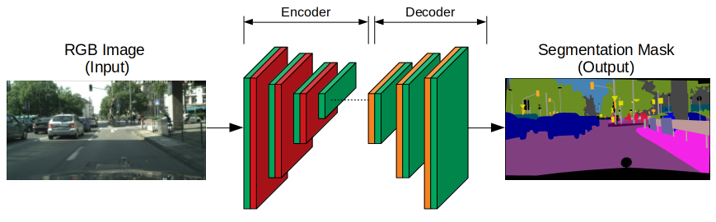
Image segmentation
https://towardsdatascience.com/espnetv2-for-semantic-segmentation-9e80f155d522

Slide 12
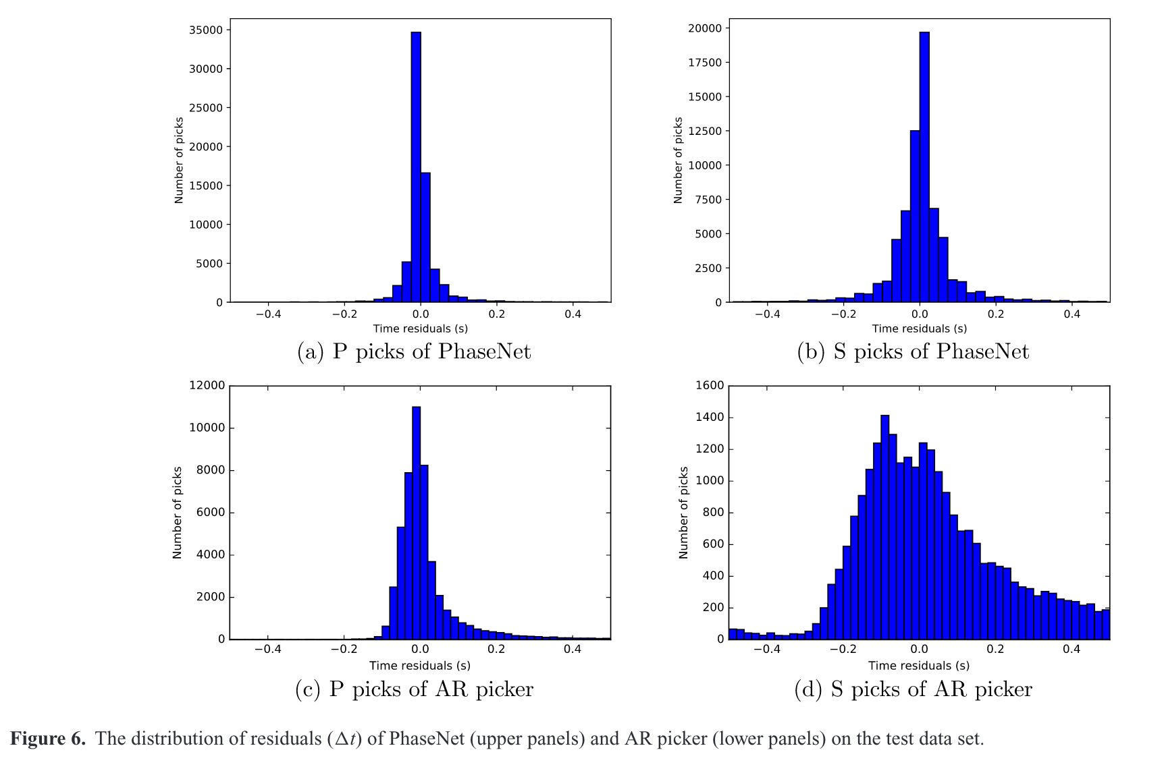
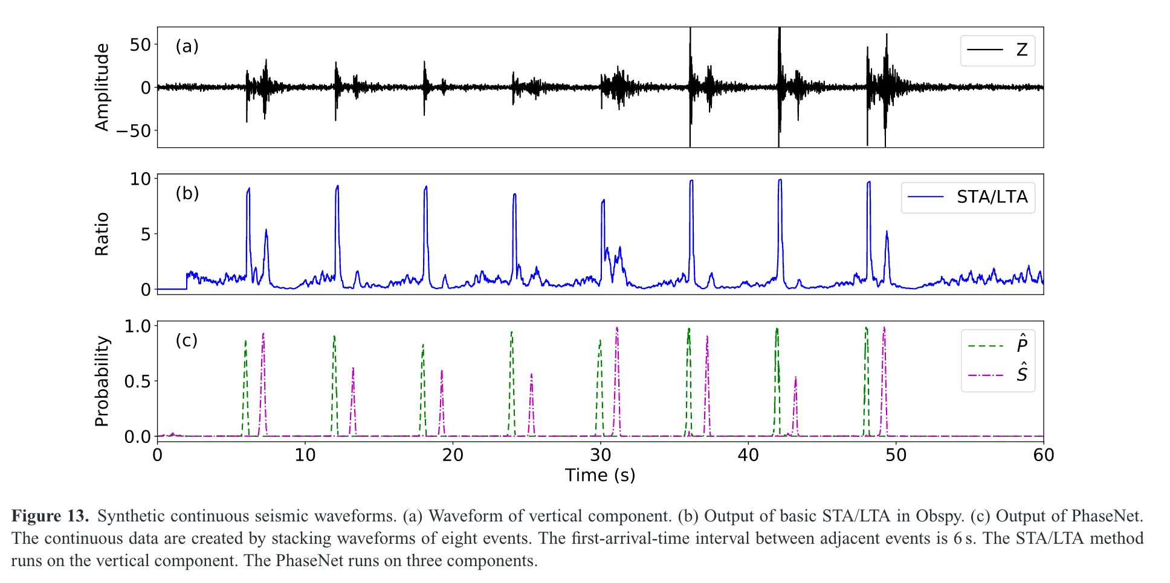
Comparison with STA/LTA
PhaseNet vastly outperforms traditional phase picking based on STA/LTA triggers
In particular, the STA/LTA method is very limited when it comes to properly identifying S-wave arrivals, but PhaseNet excels .

Slide 13
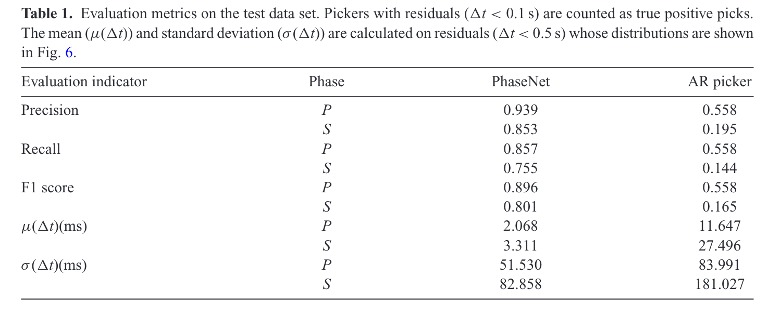
Evaluation metrics: Precision and recall
precision = true positives / (true positives + false positives)
Precision measures how accurate the classifier is when it comes to a positive outcome
High precision models make few false positive predictions, but may miss some true positives
recall = true positives / (true positives + false negatives)
Recall measures the percentage of actual positives in the dataset that were correctly predicted by the model
Models with high recall correctly identify most of the positives in the dataset, but may generate more false positives
F1 score = 2 (P x R) / (P + R)

Slide 14
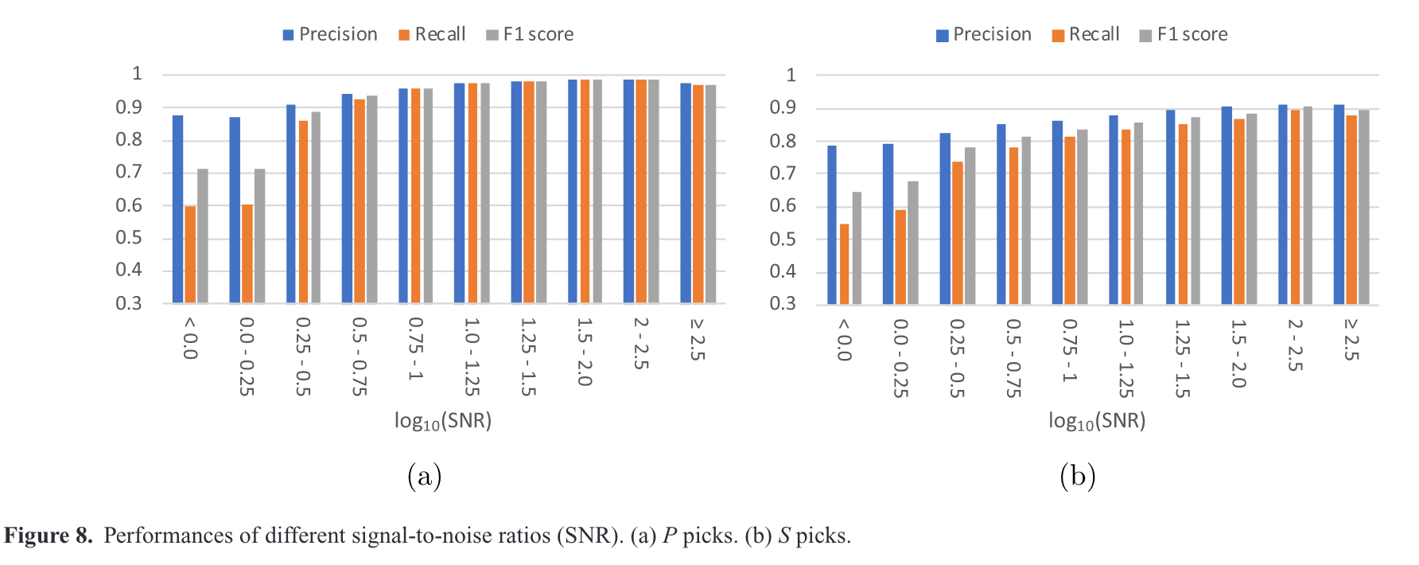
Conclusions and outlook: PhaseNet
Deep learning-based phase pickers can already rival human performance, while operating on large sets of continuous data
These approaches have the potential to vastly expand catalogs of seismic travel times, which can be used to improve models of the subsurface.
S-wave identification, in particular, is enhanced in deep learning phase pickers.
P-picks
S-picks

Slide 15
Supervised vs unsupervised learning
Supervised learning
requires labeled data sets. The labeled data is used to train the model, which learns how to optimize predictions to match the known labels.
Examples include deep neural networks for classification, large language models (e.g., ChatGPT), image generation models (e.g., DALL-E, MidJourney).
Unsupervised learning
type of machine learning that uses un-labeled data sets.
there is no ‘target’ output for the model. Rather, the model learns to uncover patterns within the data
Common examples of unsupervised learning are clustering and anomaly detection

Slide 16
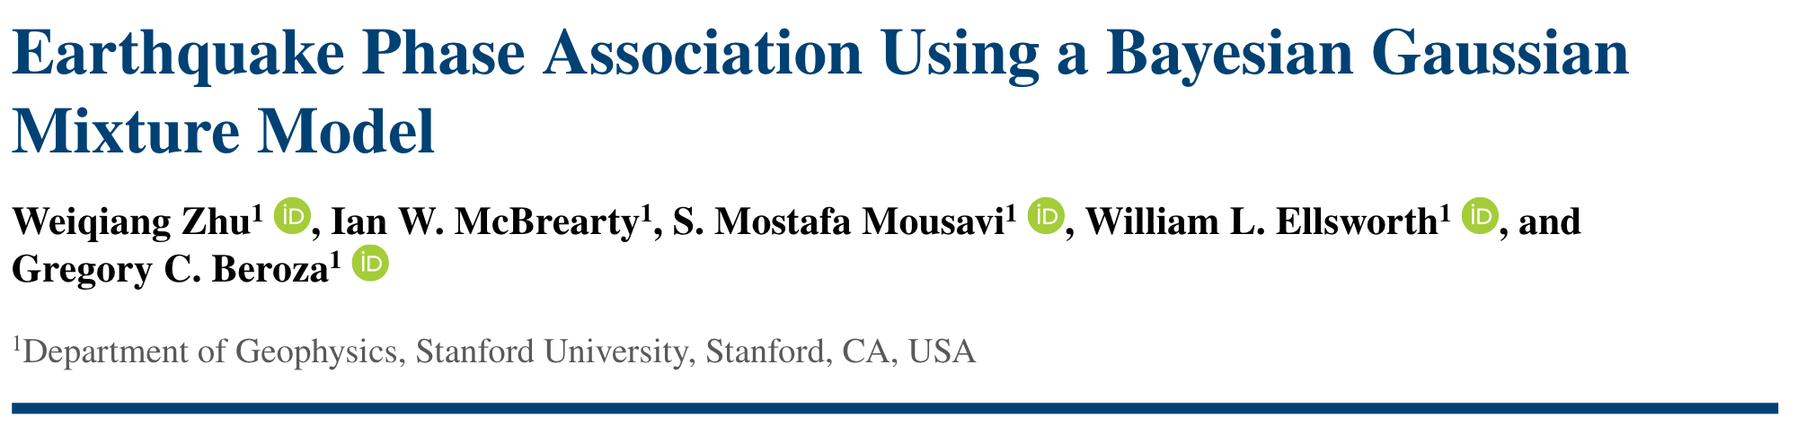

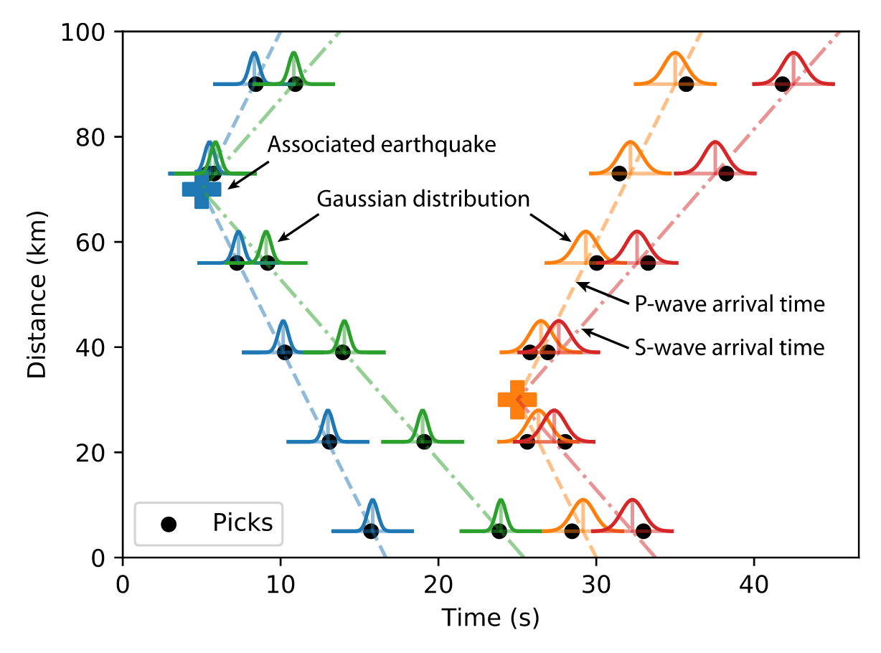
Phase picking is not the final step in an earthquake monitoring workflow… The full process requires estimating the location, origin time, and magnitude of seismic events
The location problem requires phase association
The phase association step groups phase picks together that share a common origin
This can be performed using unsupervised machine learning algorithms used for clustering (e.g., Gaussian Mixture Modeling in the case of GaMMA)

Slide 17
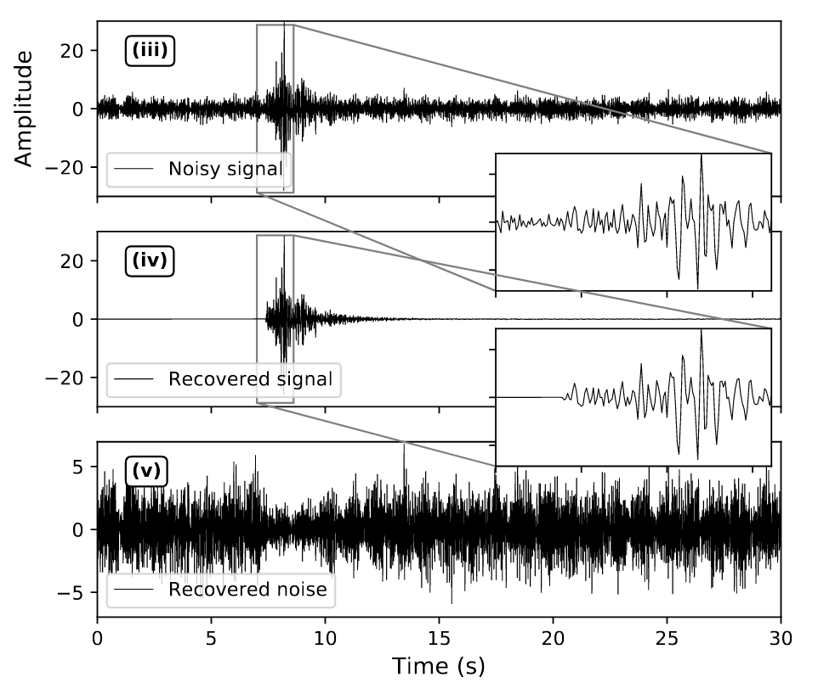
Signal ‘de-noising’
De-noising methods attempt to separate seismic signals (e.g., ground motion caused by earthquakes) from background noise (e.g., ocean waves, wind, anthropogenic sources).
Challenges arise when signal and noise overlap in time and frequency.
Deep learning approaches using supervised learning can train neural networks to automate this task.

Slide 18
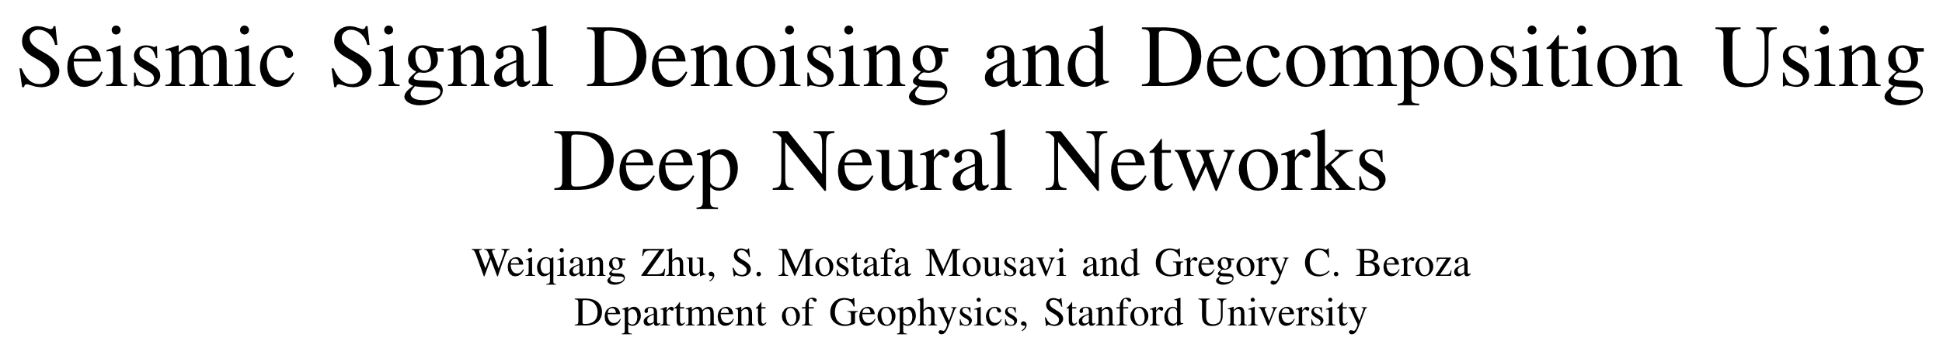
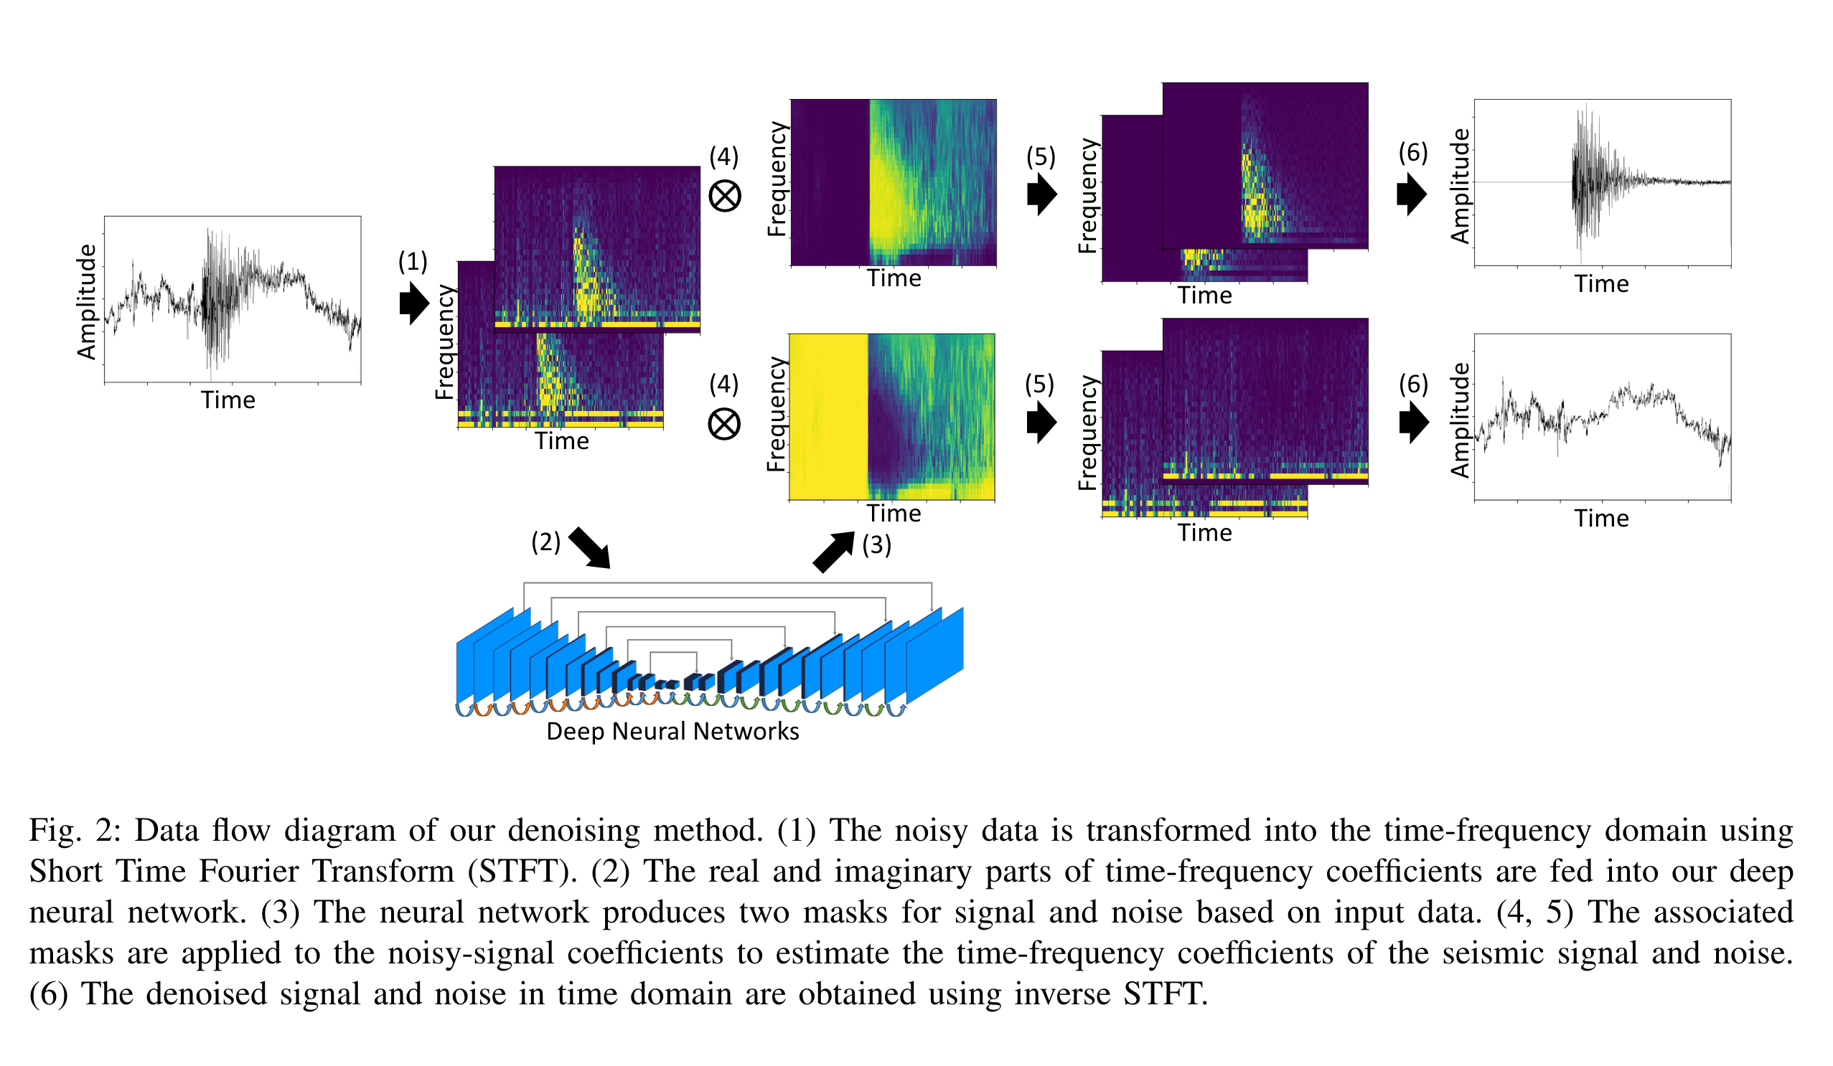
DeepDenoiser (https://github.com/AI4EPS/DeepDenoiser)
DeepDenoiser is a deep learning-based approach that works on spectrograms to separate signal from noise in the time-frequency domain
Uses a ‘U-net’ architecture, which learns two masks: one for the signal and one for the noise
The masks of signal and noise in the time-frequency domain are transformed to the time domain

Slide 19
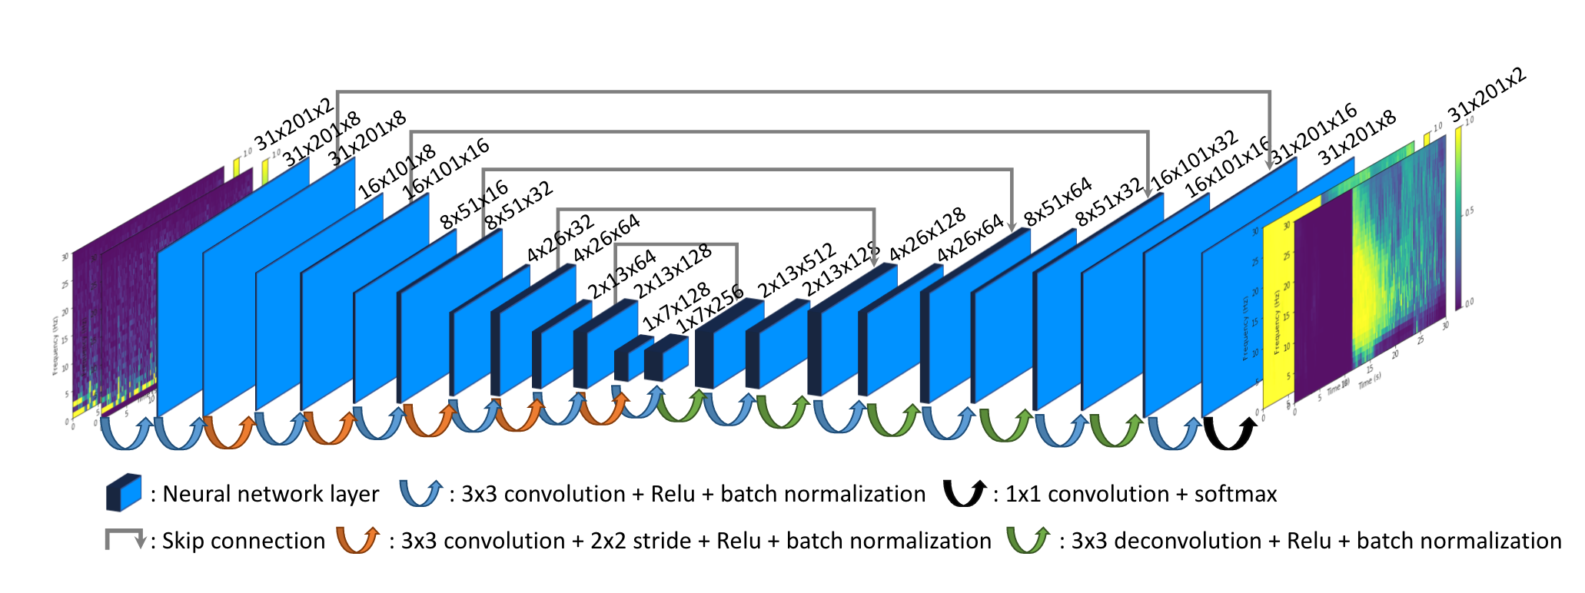
Data set and architecture of DeepDenoiser
Training data set consists of 56,345 high SNR earthquake waveforms (used as the ‘signal’ samples) and 179,233 seismograms of various types of non-earthquake signals (used as the ‘noise’ samples). 30 s waveform samples collected from the North California Seismic Network are used.
’Noisy’ seismograms are generated by randomly adding a noise sample to a signal, with variable SNR
The prediction targets (i.e., labels) are the time-frequency representations of the either the signal or noise

Slide 20
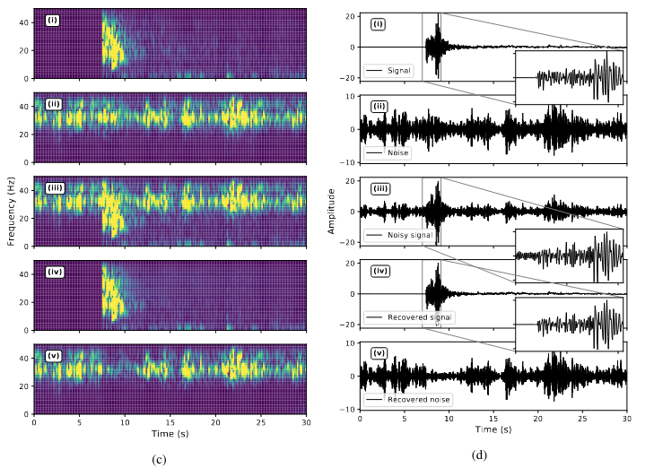
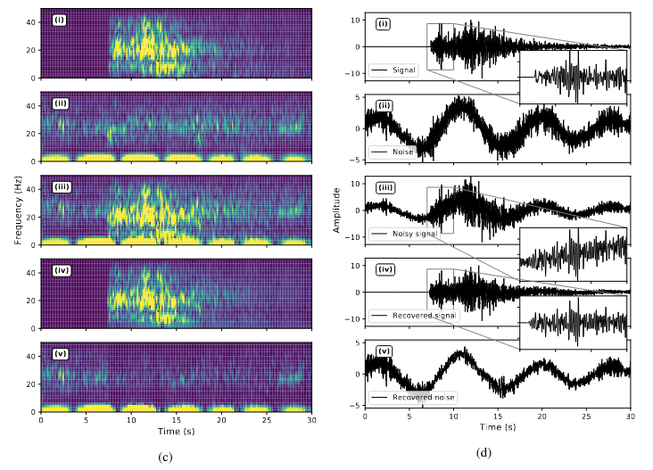
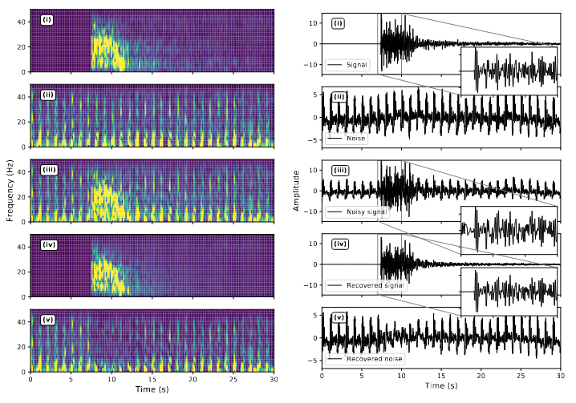
Performance of DeepDenoiser
The network is able to learn how to separate signal from noise, even in cases where the signal and noise overlap in time and frequency.
Works on a variety of different types of noise.
Does not recover signal if given waveforms of pure noise.
How well does it generalize? Hard to say how well it will work on data from different regions.
Band-limited noise
‘Colored’ noise
Cyclic non-seismic signals

Slide 21
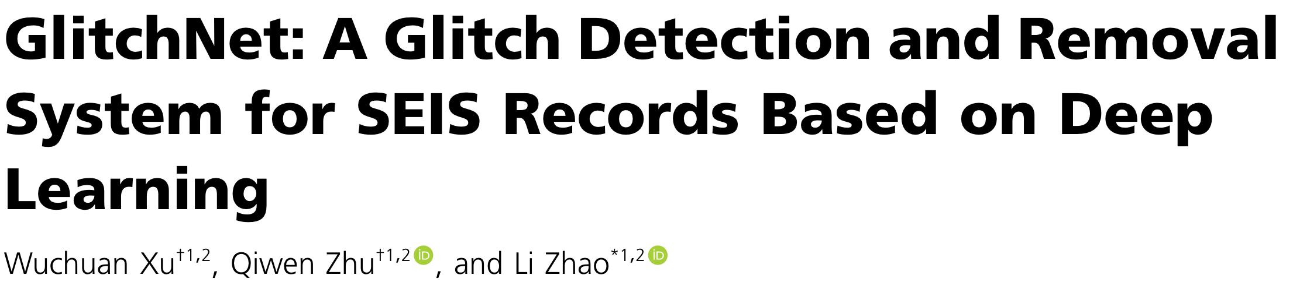
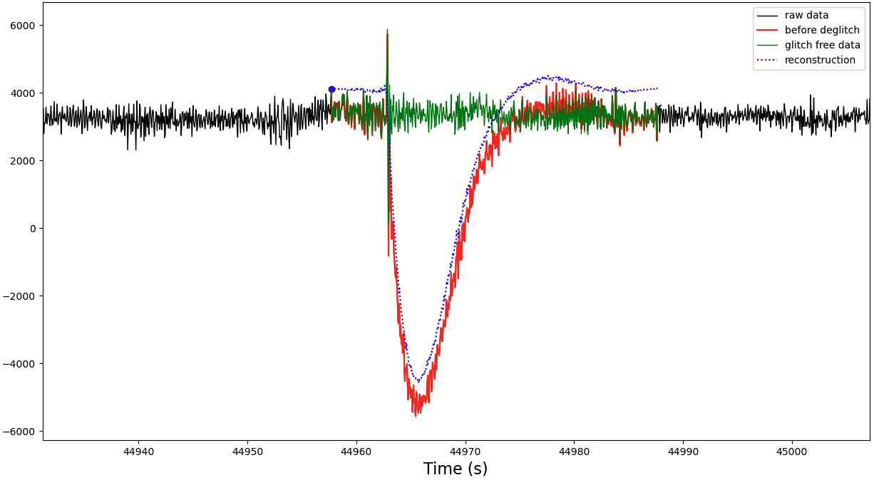
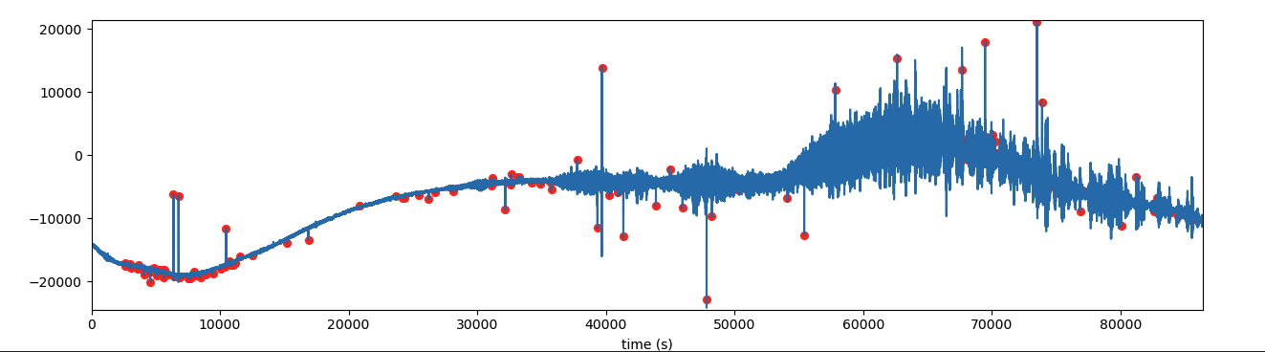
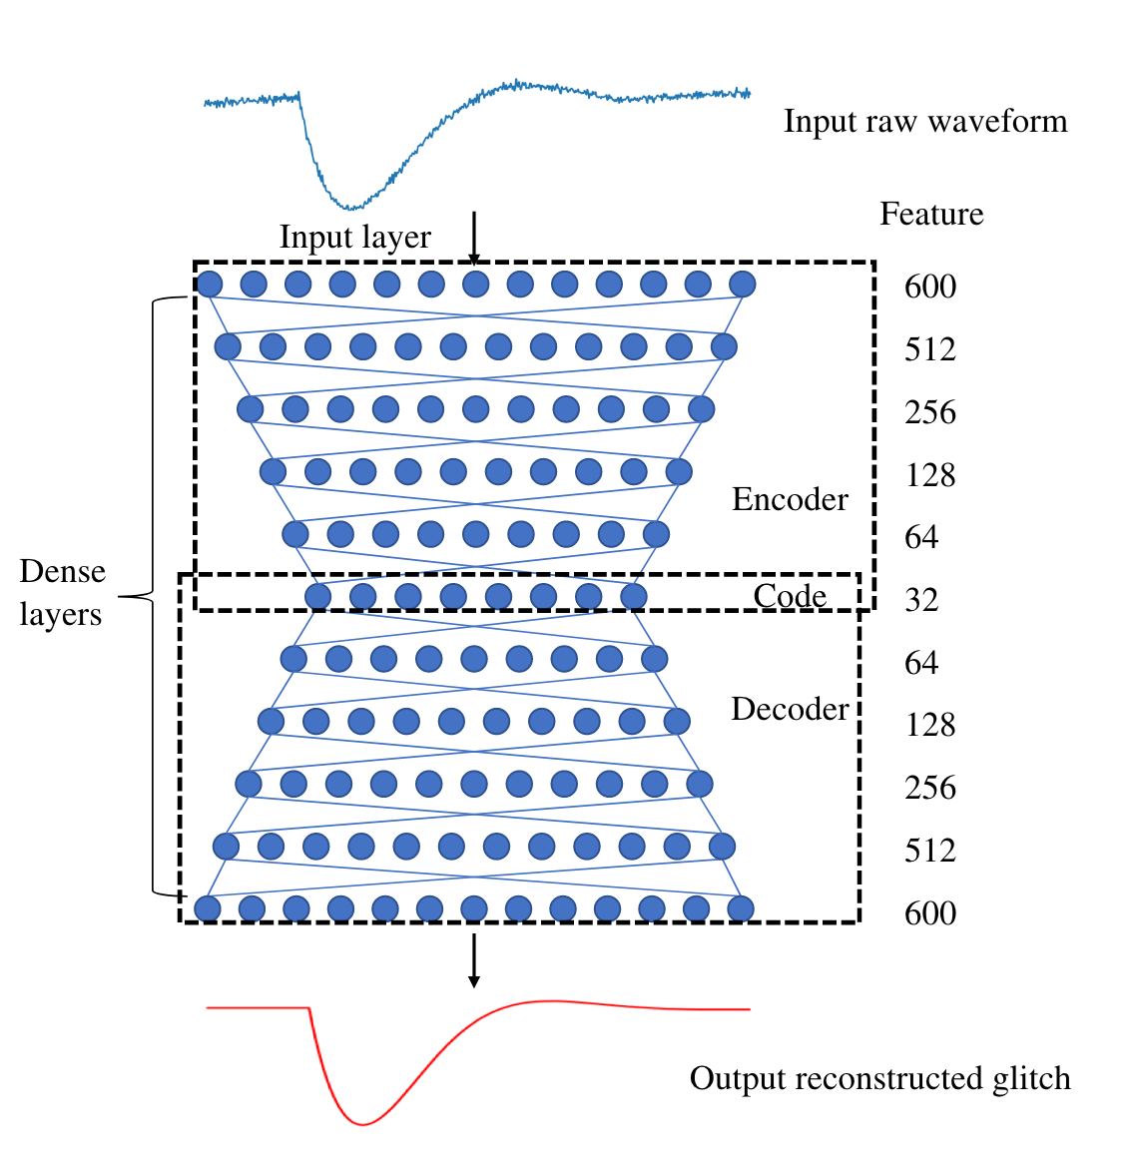
GlitchNet: ‘De-noising’ application applied to Mars InSight data
glitch
Instrument ‘glitches’ are one of the most common forms of unwanted signals in continuous data from the SEIS VBB (very-broadband) seismometer.
Glitches can contaminate multiple types of seismic analyses.
GlitchNet is neural network trained on a catalog of known glitches. The trained network takes continuous raw waveform data and detects and removes instrument glitches.

Slide 22
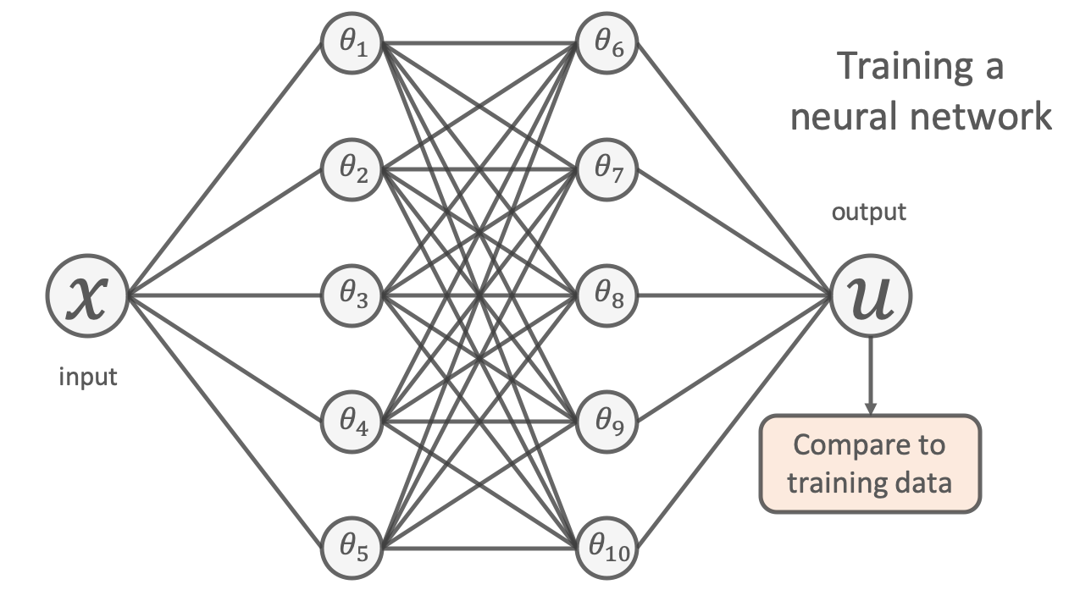
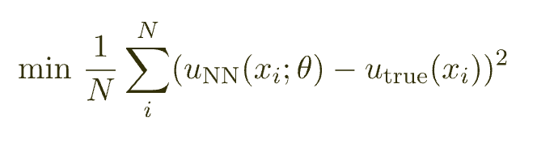
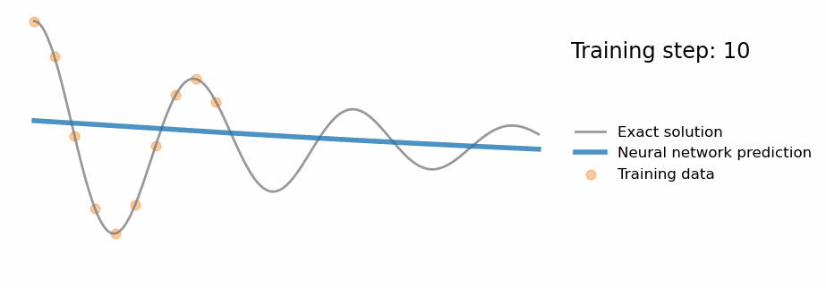
Physics informed neural networks (PINNs)
Conventional neural network
Type of neural network that incorporates known physics (e.g., partial differential equations that govern a process) during training.
Useful if solving governing equations is challenging with conventional numerical methods.
Add known governing differential equations directly into the loss function.
Although PINNs have only recently gained popularity, they have already been applied to many problems, including wave propagation, fluid dynamic simulations (e.g., Navier-Stokes), and more
https://benmoseley.blog/my-research/so-what-is-a-physics-informed-neural-network/

Slide 23
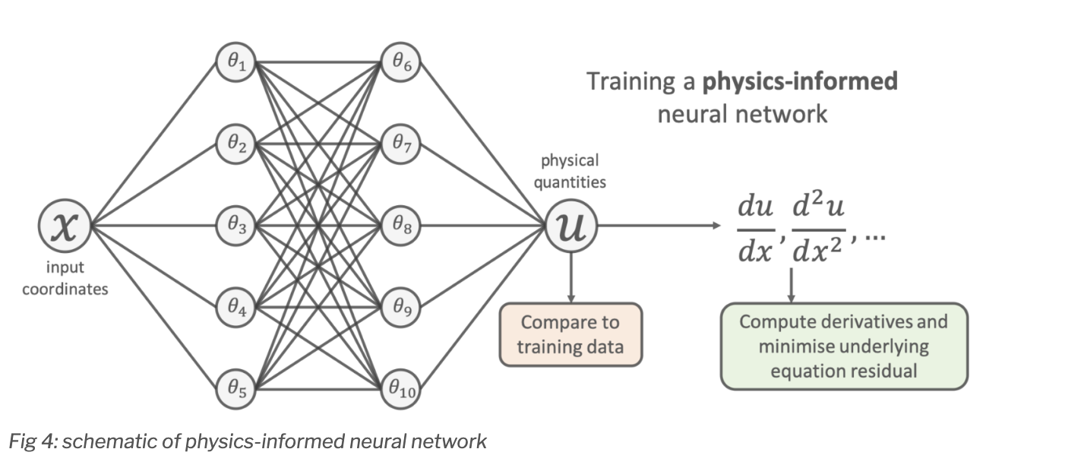
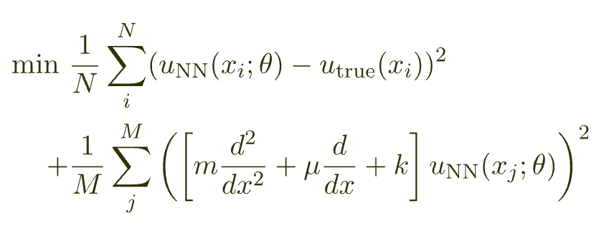
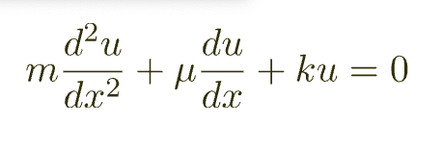
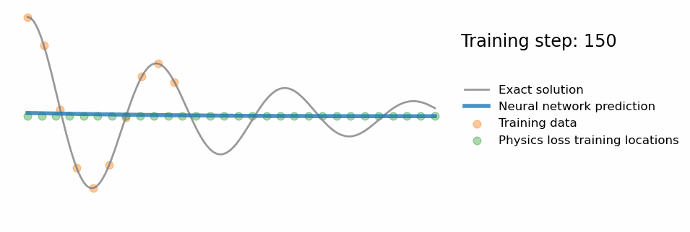
Physics informed neural networks (PINNs)
Physics informed neural network
Type of neural network that incorporates known physics (e.g., partial differential equations that govern a process) during training.
Useful if solving governing equations is challenging with conventional numerical methods.
Add known governing differential equations directly into the loss function.
Although PINNs have only recently gained popularity, they have already been applied to many problems, including wave propagation, fluid dynamic simulations (e.g., Navier-Stokes), and more
https://benmoseley.blog/my-research/so-what-is-a-physics-informed-neural-network/

Slide 24
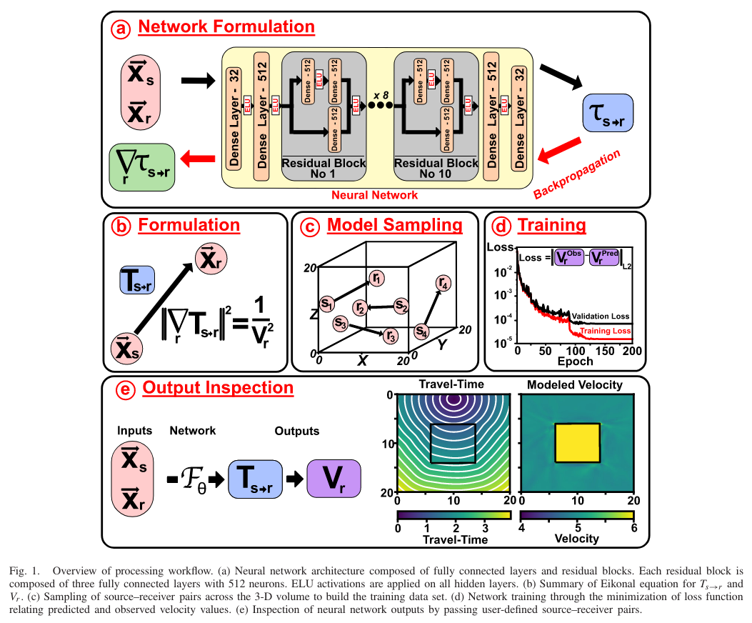
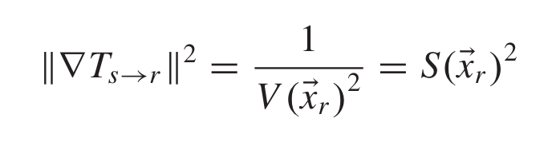
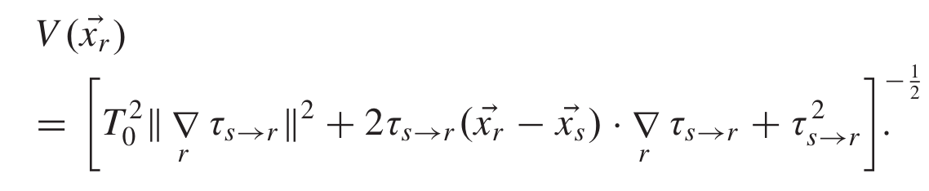
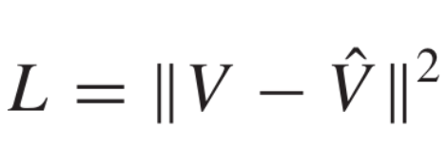
EikoNet: Solving the Eikonal equation (Smith et al., 2021)
Eikonal equation: used for calculating ray paths and travel times through velocity models
T = travel time, s = source, r = receiver, V = velocity
Goal during training is to find network parameters that minimize the degree to which this equation is violated.
Inputs: Known velocity model V(x), source/receiver locations
Outputs: Travel times between source(s) and receiver(s)
predicted by network
Loss: difference between network predicted velocity and known velocity model

Slide 25
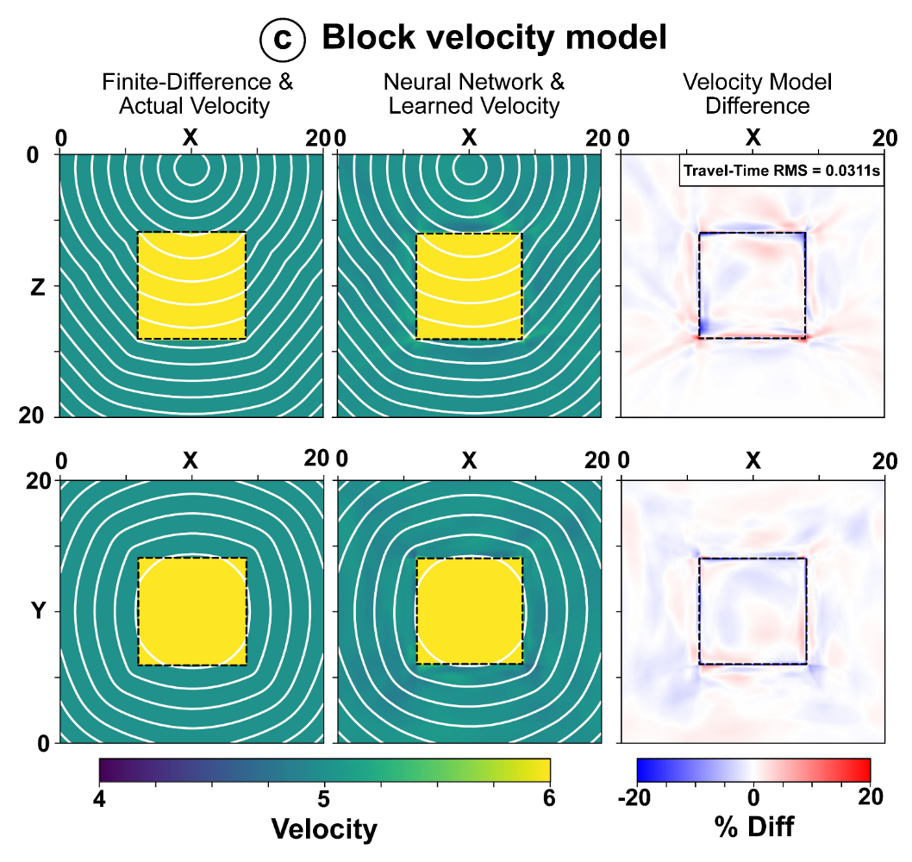
EikoNet performance
Travel time results for complex 3D models are consistent with direct solutions from numerical methods (e.g., finite differences)
Pros
For pre-trained models, the travel time calculation using EikoNet is much faster than conventional numerical methods
Cons
- Network needs to be trained for every new velocity model (doesn’t generalize to new velocity models)

Slide 26
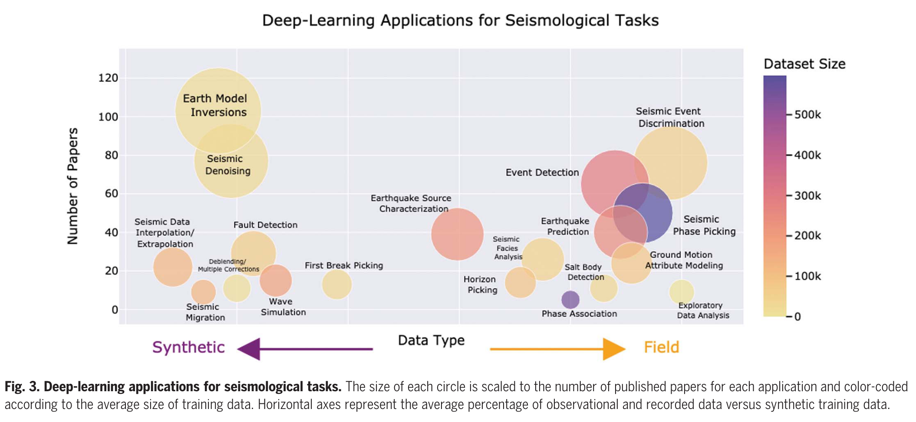
Summary of machine learning applications

